Slide 1


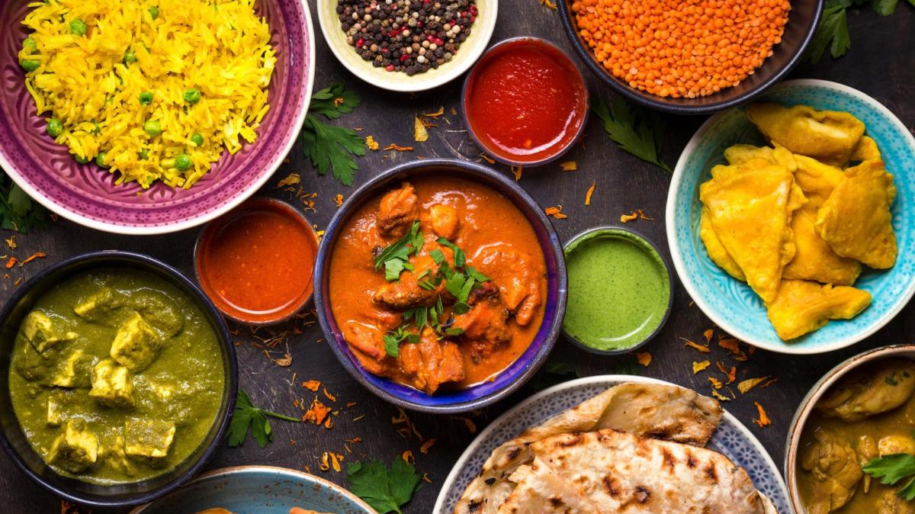
Deep Transfer Learning and Data Augmentation for Food Image Classification
Group - 03
Authors: Doaa AL-RUBAYE & Serkan AYVAZ

Slide 2




GROUP MEMBERS
NAME | ID
MOHAMMED TANVIR HASSAN | 22-46481-1
SABBIR AHMED | 22-46486-1
MD. NAIMUR RAHMAN | 22-46521-1
FAIZA BINTE ZAMAN | 22-47256-1
Supervised By:
Dr. Debajyoti Karmakar
Associate Professor
Department of Computer Science
Faculty of science and Technology
American International University - Bangladesh

Slide 3
OVERVIEW
Introduction
Discussion
Related Works
Conclusion
Methodology
Future Approach
Result
Thank You

Slide 4
INTRODUCTION
Obesity and health risks
Obesity is linked to serious health risks including diabetes, heart disease, and certain cancers.
Food insecurity
Global food insecurity is another major problem, with 690 million people undernourished in 2022
Problems
Leveraging Deep Learning
Transfer learning, can be used to address food insecurity and obesity.
Enhancing Food Image Classification
By harnessing pre-trained models and advanced algorithm, efficiency and accuracy can be enhance
Informed Decisions
Individual can make healthier food choice
Solutions

Slide 5

RELATED WORKS
+24K
Food – 5K
FoodX - 251
•2500 food images from various sources
•Utilized AlexNet and VGG16 architecture
•99% accuracy.
•251 micro-classes with 158k images
•Used ResNet-101
•Top-3 Error of 17% after fine-tuning.
+10K
UEC – FOOD - 256
UEC – FOOD - 100
•2500 food and non-food images
•Used Inception-V3
•Top-1 accuracy of 88.28% and Top-5 accuracy of 96.88%.
•Contains 14,361 images with detailed annotations
•Used ResNet50
•Top-1 accuracy of 41.72% in advanced configurations.
+50K
Food – 101
Various studies including the use of DenseNet-161 with Top-1 accuracy of 93.27%, and EfficientNetB0 achieving 80% accuracy.
+19K

Slide 6
METHODOLOGY
Data Augmentation
Necessity for Data Augmentation
Insufficient number of samples per class for effective training and testing.
Methods of Augmentation
Vertical-to-horizontal flipping.
Rotating images.
Manual addition of images.
Challenges in Augmenting Data
Variability and quality issues in Internet-sourced images.
Tedious and time-consuming process of manual image selection and editing.
Specific issues with certain food classes.
Data Collection
Description of the FOOD–01 Dataset
Composition: 101,000 images divided into 101 categories.
Characteristics: Real images representing various meals from different cultures.
Challenges of FOOD–101 Dataset
Similarity between different food classes
Variability within classes.
Presence of extraneous objects in images that add noise.

Slide 7

TECHNOLOGY USED
Model Configuration
Optimizer : Adam
Learning Rate : 0.0001
Epochs: 50
Batch Size: 16
Training Data: 80%
Validation Split: 20%

Slide 8
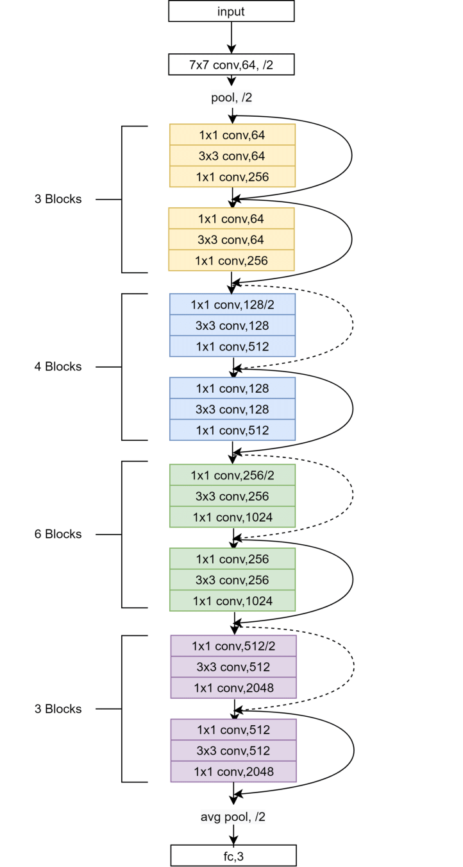
TECHNOLOGY USED
ResNet50 Architecture
Structure and Layer Breakdown
50 layers, including convolutional layers, identity blocks, and convolution blocks
Five stages.
Function of Residual Blocks
Each block includes skip connections that help preserve the gradient flow through the network.
Trainable Parameters
23 million trainable parameters
01 - BRANDING
02 - WEBSITE
03 - SOCIAL MEDIA
Figure 1: ResNet50 Architecture

Slide 9
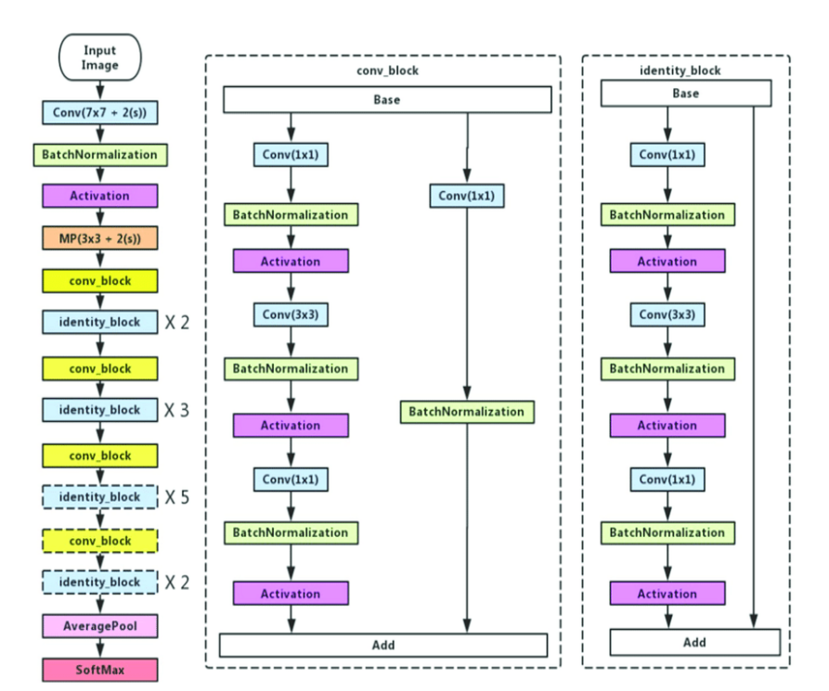
TECHNOLOGY USED
ResNet50V2 Architecture
An enhanced version of the original ResNet50 model.
Performance
Demonstrates superior performance on the ImageNet dataset
Architectural Changes
Alteration in skip connections.
Objective
The adjustments aim to improve learning in deeper networks by modifying the flow of information in residual paths.
01 - BRANDING
03 - SOCIAL MEDIA
Figure 2: ResNet50V2 Architecture

Slide 10
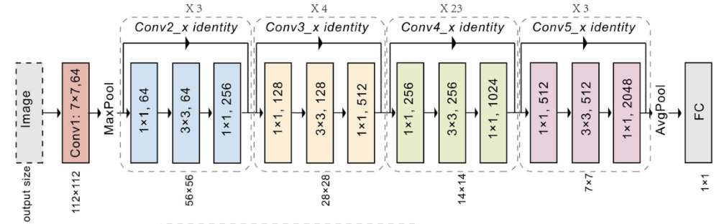
TECHNOLOGY USED
ResNet101 Architecture
.Training and Pre-taraining
Pre-trained on the ImageNet dataset
During training on ImageNet it learns to recognize a broad range of objects
Architectural Design
Network consisting 101 layers
Processes images at resolution of 224 x 224 pixels
Figure 3: ResNet101 Architecture

Slide 11
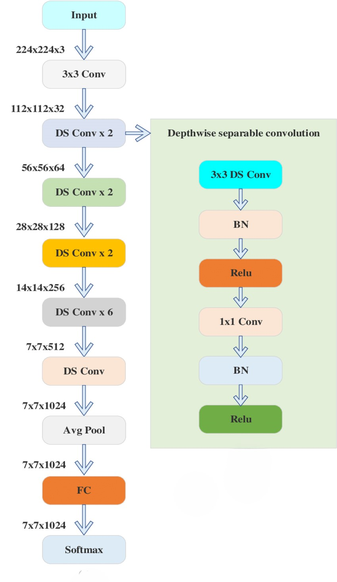
TECHNOLOGY USED
MobileNet Architecture
Designed for Mobility
Reduced Architecture
Deep-Separable Convolutions
Lightweight and Low-Latency
Versatile Application
Figure 4: MobileNet Architecture

Slide 12
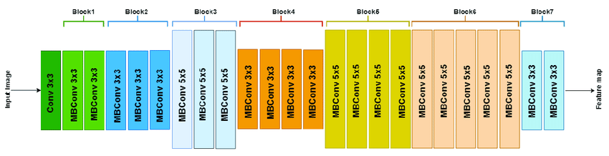
TECHNOLOGY USED
EfficientNetB1 Architecture
Scaling technique
Compound coefficient
Decoder blocks in upsampling network
Convolution layers with ReLU activation
Batch normalization
Softmax convolution layer
Figure 4: EfficientNetB1 Architecture

Slide 13
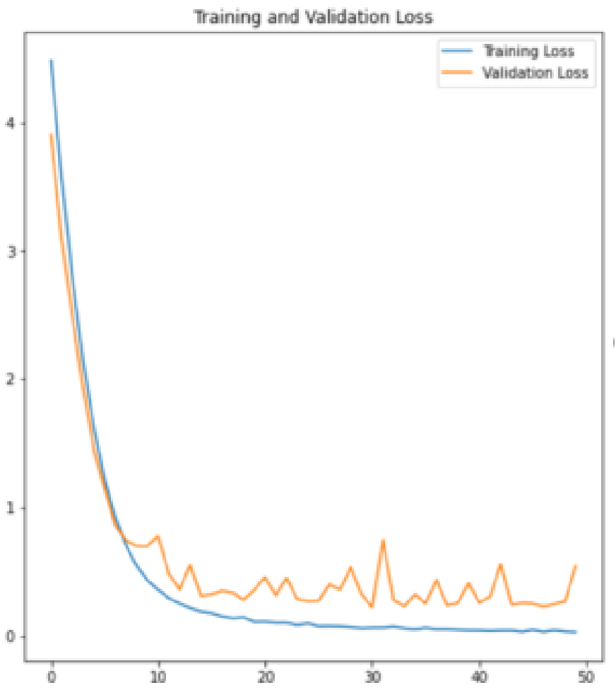
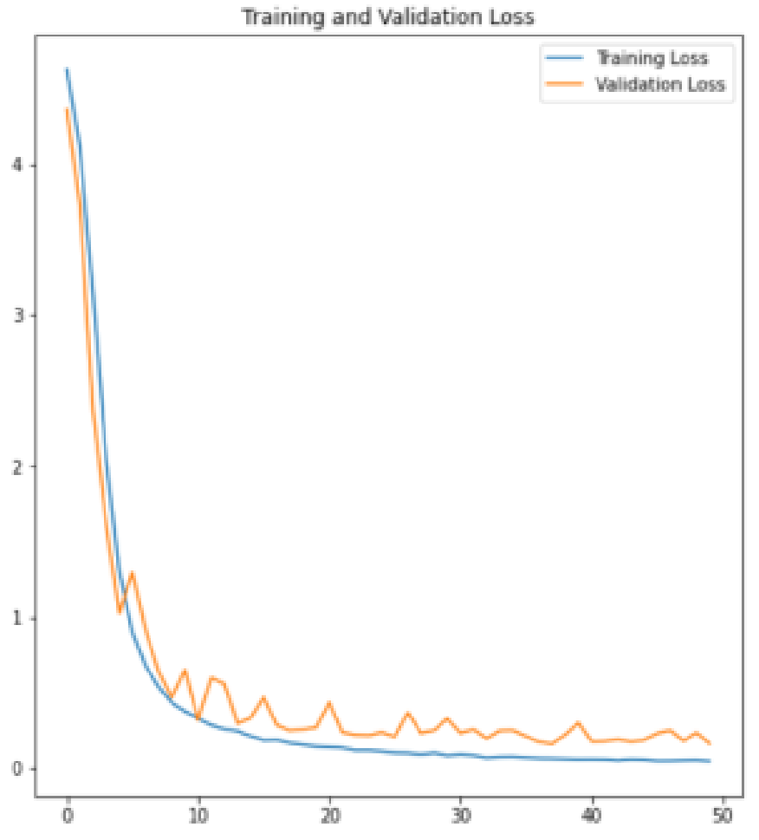
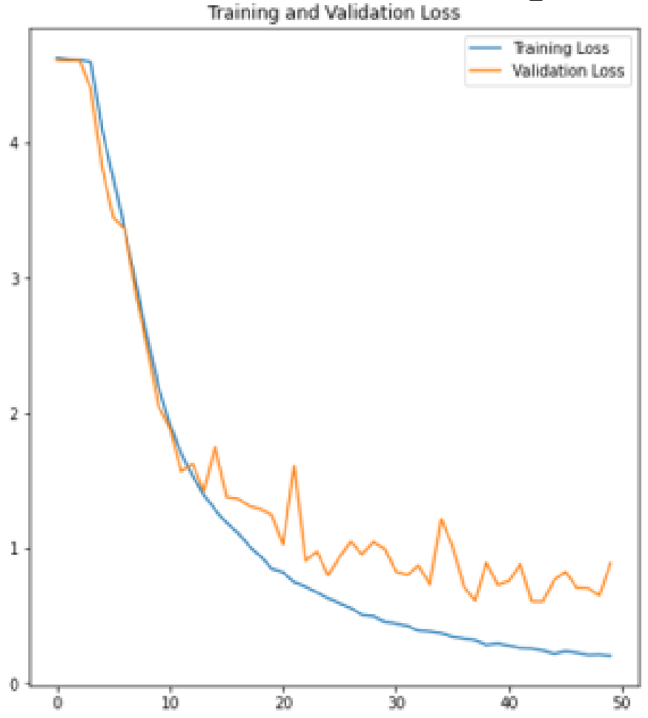
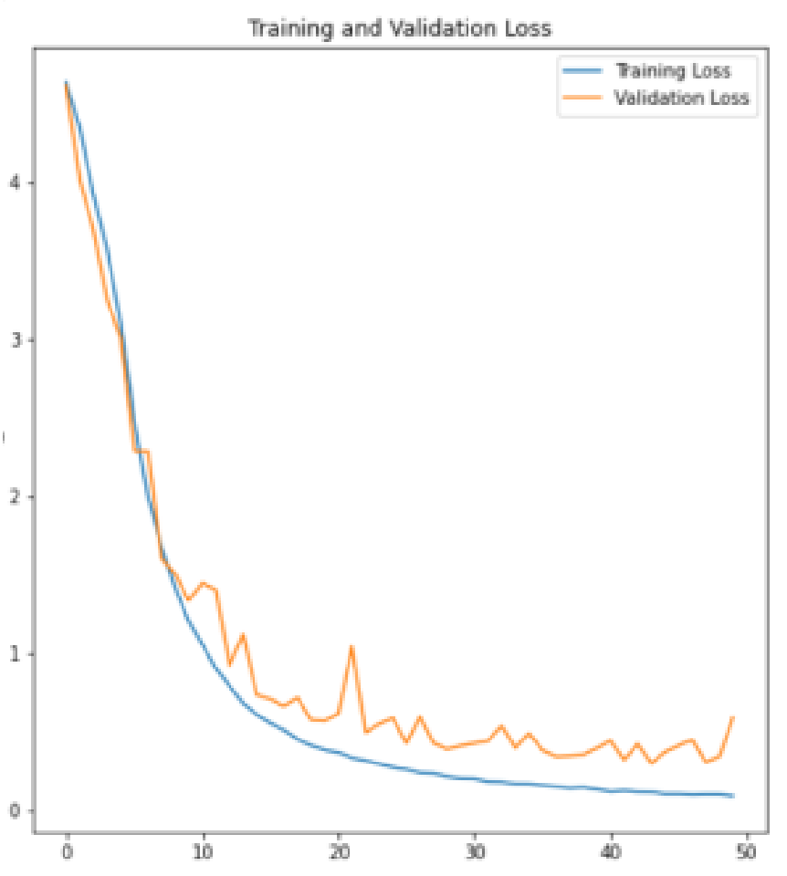
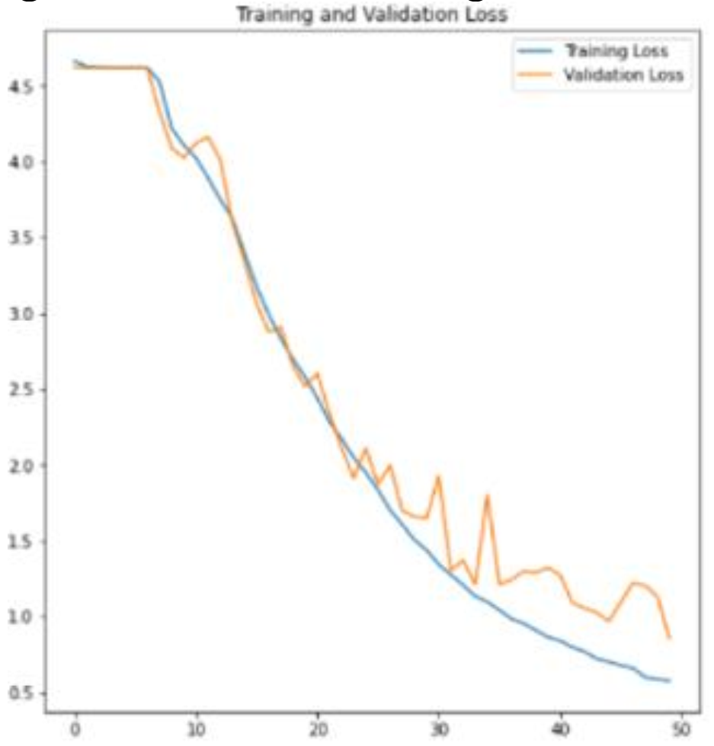
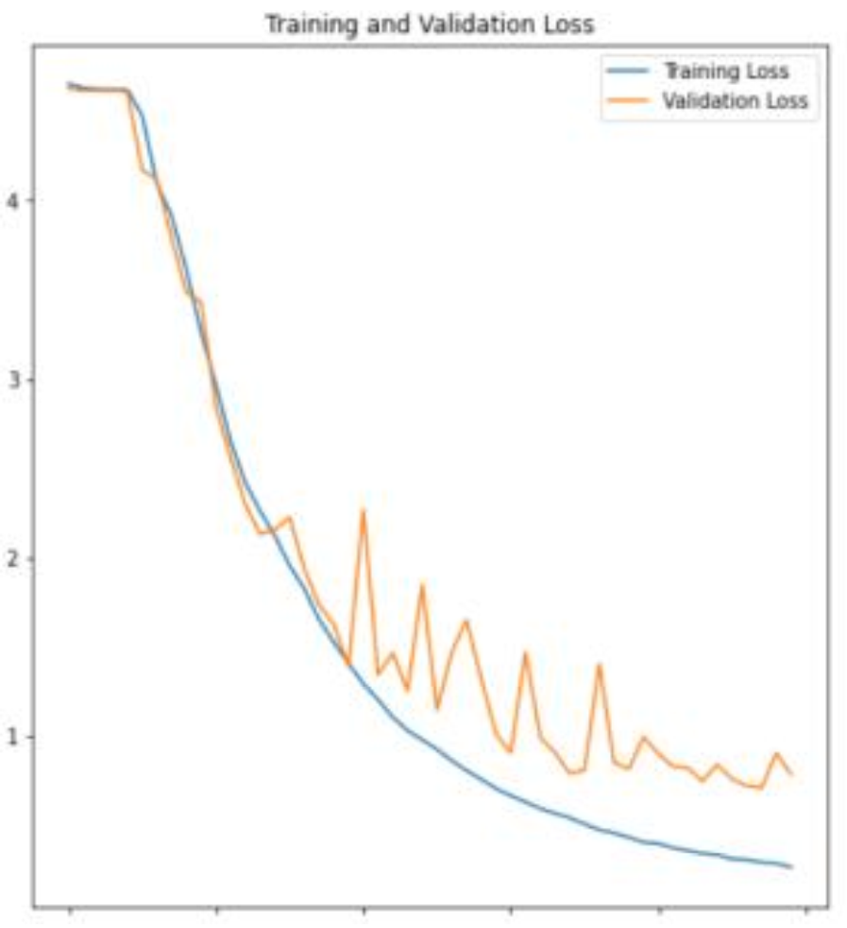
Training and Validation Loss
Architecture Name | Without Augmented Data | With Augmented Data
ResNet50
ResNet50V2
ResNet101

Slide 14
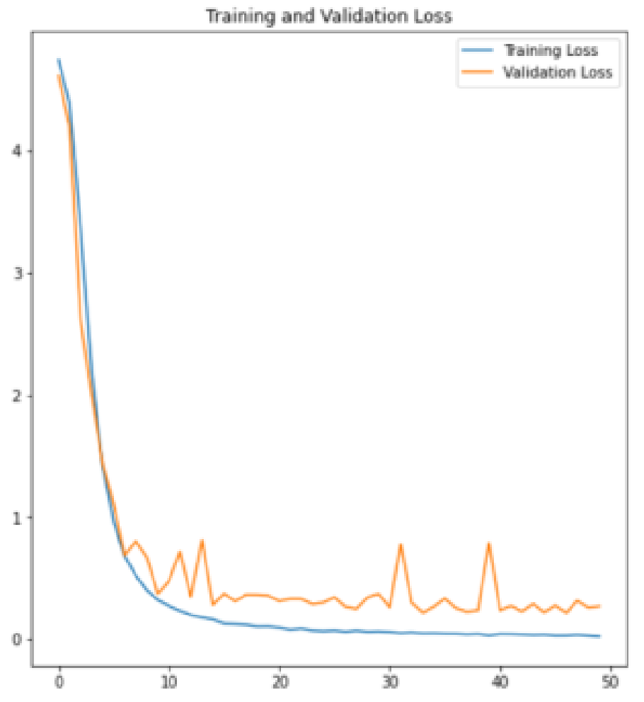
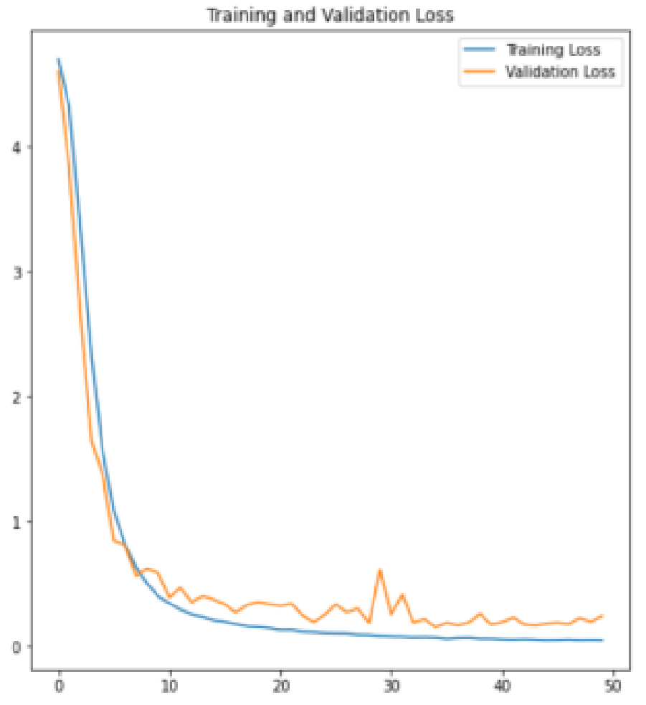
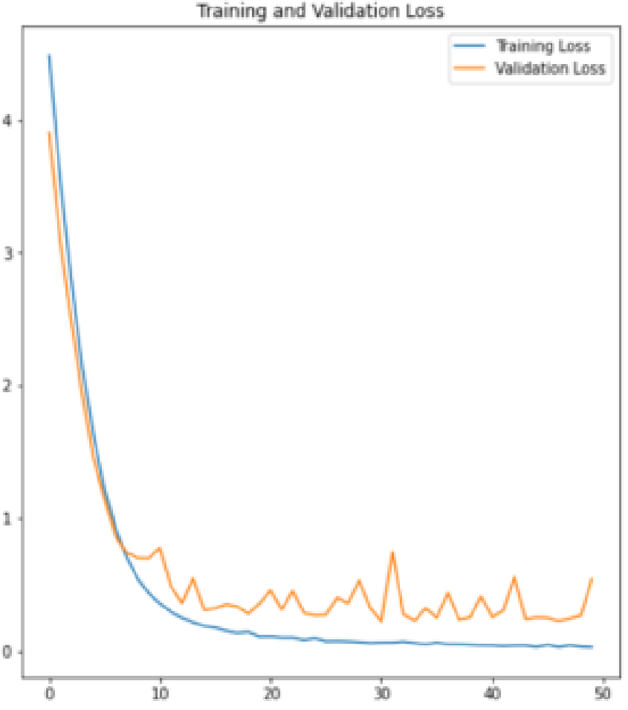
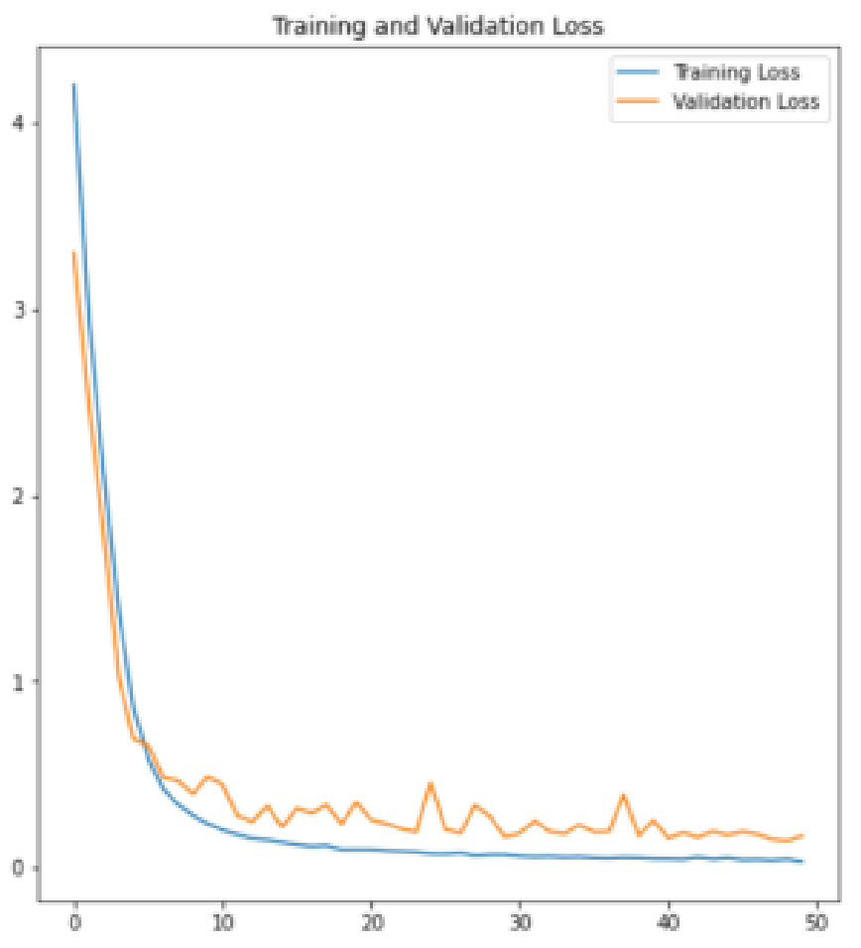
Training and Validation Loss
Architecture Name | Without Augmented Data | With Augmented Data
MobileNet
EfficientNetB1

Slide 15
RESULTS
Model | Accuracy on FOOD-101 | Accuracy on Augmented FOOD-101
MobileNet | 95% | 94.25%
ResNet50 | 94% | 95.84%
ResNet50V2 | 80% | 85.97%
ResNet101 | 76% | 79.77%
EfficientNetB1 | 89% | 96.13%
Table: The Model Comparison Results

Slide 16
DISCUSSION
The integration of transfer learning with data augmentation significantly enhances model performance in food image classification.
The study notes that complex models like ResNet101 do not necessarily perform better than simpler models like ResNet50 in food image classification tasks.
Including a diverse array of real-world food presentations in the training data helps to reduce biases inherent in syntactic data generation methods.
The results encourage further exploration into efficient model architectures and the continued augmentation of datasets to enhance real-world application performance.

Slide 17
CONCLUSION
This study enhanced food image classification by applying transfer learning and augmenting the Food-101 dataset. Simpler models like ResNet50 and MobileNet outperformed more complex ones. Data augmentation improved accuracy, especially in underrepresented classes. Future work will focus on developing a mobile app to assist the visually impaired.
OCT
MAY

Slide 18
FUTURE APPROACH
Expanded Applications
Improved food image classification can assist the visually impaired, help travelers with dietary restrictions, enhance food safety, and improve marketing strategies through targeted dietary preferences.
Enhanced Model Performance with Data Augmentation
Continued refinement of these techniques to train more robust models.
Integration into Consumer Technology
Integrating advanced food image classification models into a smartphone app to help users, including the visually impaired, identify food items via their phone's camera in settings like buffet restaurants.
Improvement in Deep Learning Architectures
Despite the promising results from current there is potential to explore and improve other architectures to boost accuracy and efficiency, particularly for real-world applications where computational resources are limited.
Reduction of Bias in Model Training
Develop more sophisticated techniques to generate training data that better represents the diversity and variations of real-world food images.

Slide 19
THANK YOU

